Slide 1





ঋতু
Heal The World.
Our mission and goals for the future

Slide 2

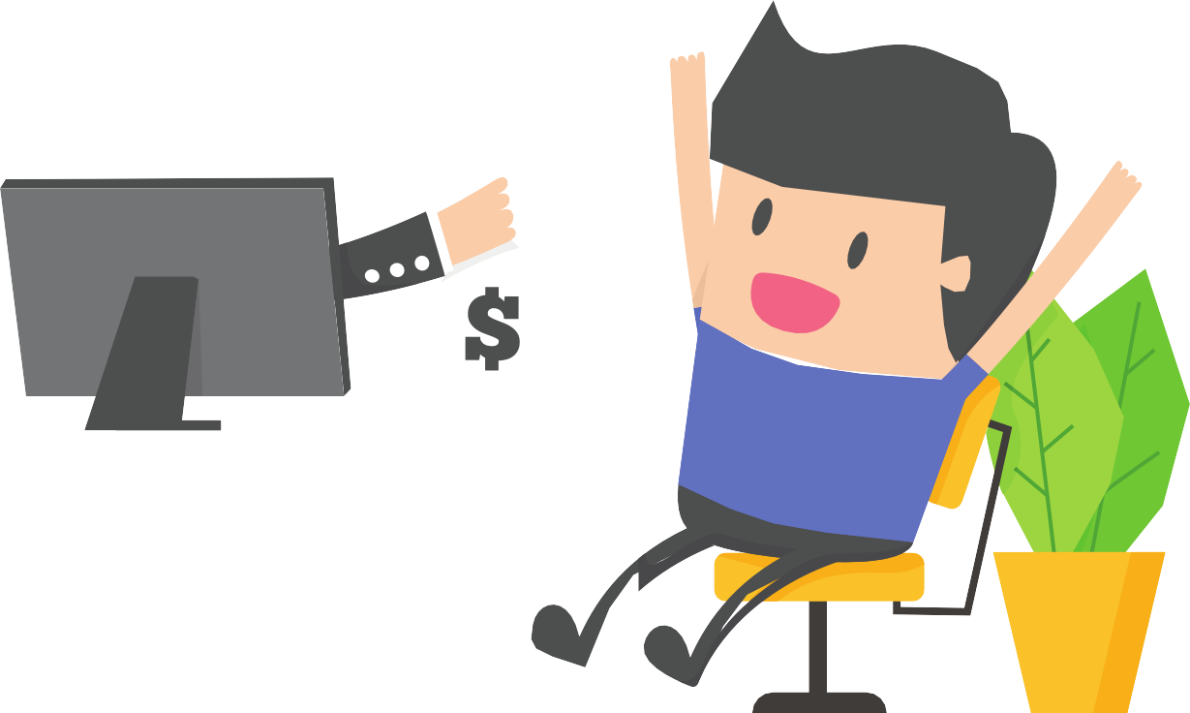

ADVANTAGES OF INSTALLING OUR GAME
1.GETTING REWARDS AND MONEY
2. CITIZEN REWARDS
3.GETTING A POLLUTION FREE ENVIRONMENT

Slide 3



ABOUT THE GAME
10 Tasks per season (Total season=6)
Rewards in every season
PERFORMING TASK FOR THE WELFARE OF THE ENVIRONMENT

Slide 4

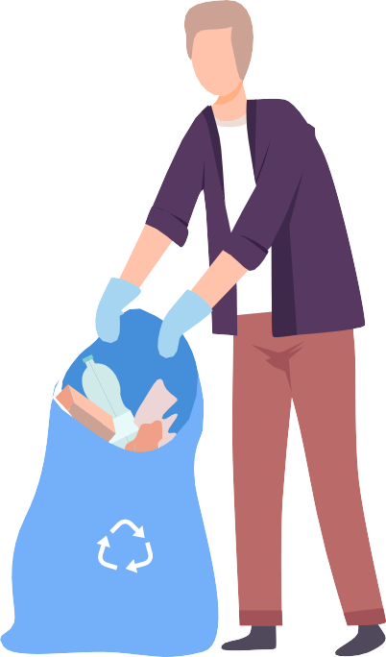
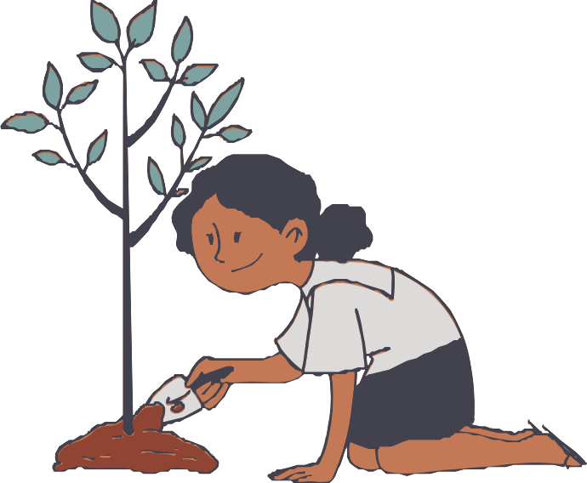






Advertising Through Hashtags Collecting Plastics
Some Tasks of the Game
Planting tress
Using long lasting bulbs
Using Jute Bags
Cleaning Roads
Promoting organic farming

Slide 5


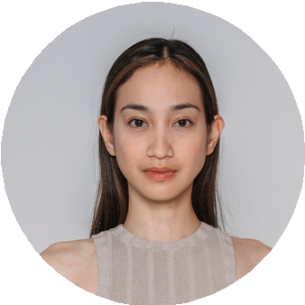
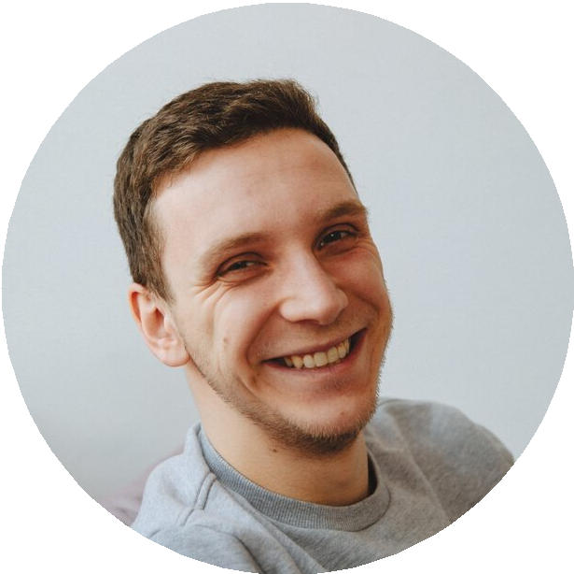

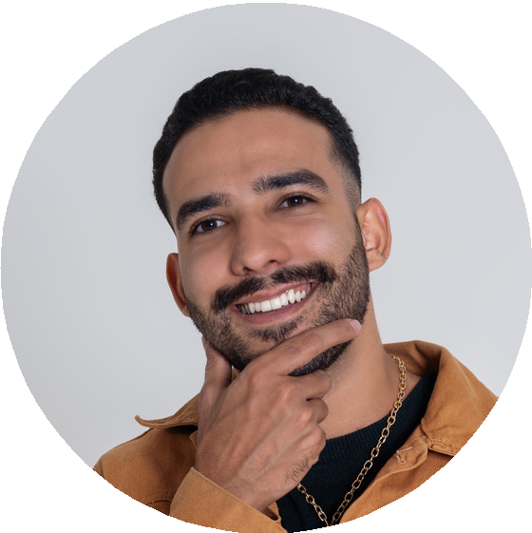
LEADERBOARD
Position
Tasks Won
Total points
Seasons Played
1.
Joanne
10
97.5
1
2.
9
85.5
1
Darrel
3.
8
80
1
Jen
4.
Aries
7
68
1

Slide 6


System Architecture of the app

Slide 7


USER DATA
MAIN
UI
REGISTRATION
SQL DATABASE
LOGIN
PLAYER
INTERFACE
DATA QUERY
SORTING
ALGORITHM
POINTS DATA
FINAL
UI
LEADERBOARD
TASKS

Slide 8



Slide 9

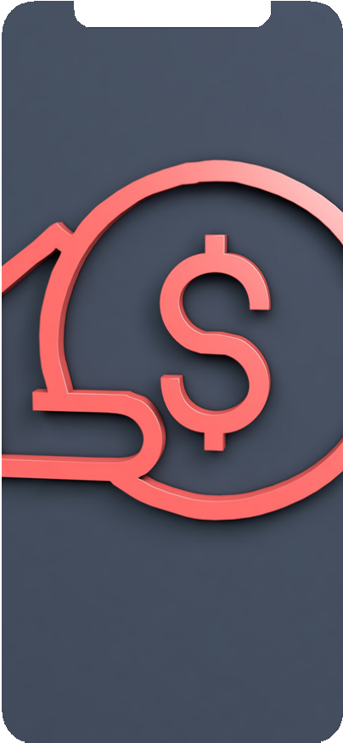
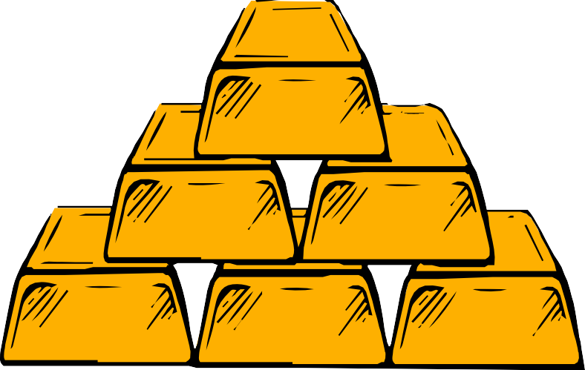
HOW DO WE MONETIZE
IN-GAME ADVERTISING
IN-GAME PURCHASE

Slide 10
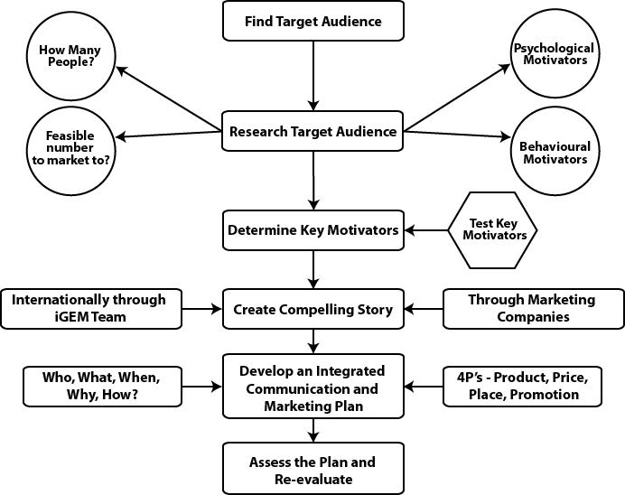
CAPITAL OVERFLOW

Slide 11






HOW DO WE PROMOTE OUR PRODUCT?
SOCIAL MEDIA
POSTS (facebook, instagram)
INFLUENCE MARKETING
( influencer, celebrities)
3
1
Video content (youtube, facebook,instagram)
2
HASHTAGS
(facebook, instagram)
4

Slide 12
HOW DO WE GET OUR FUNDINGS?
3 step Funding plan

Slide 13

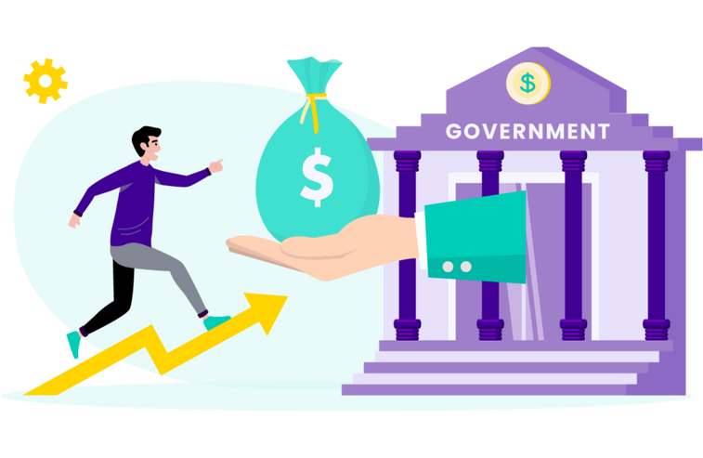

HOW OUR COMPANY GETS BENEFITTED
1. COMPANY SPONSORS
2. GOVERNMENT FUNDING
3. IN GAME PURCHASE

Slide 14





30%
30% of the total game income will be given to the season winner
SEASON WINNERS
50% of the total income will be given to the Investors
50%
Investors
20%
Rest of the money is retained to the company fund
COMPANY FUND
14

Slide 15


Total income
PROFIT BREAKDOWN SAMPLE
10,000$
3,000$
5,000$
2,000$
Season WInners
Investors
Company Fund

Slide 16
Future Goals Of Ritu.
Many more features to come !

Slide 17

Thank you!
Download RITU for a Better World

